Slide 1
Chapter 1 – An introduction to Tissue Engineering; the topic and the book

Slide 2
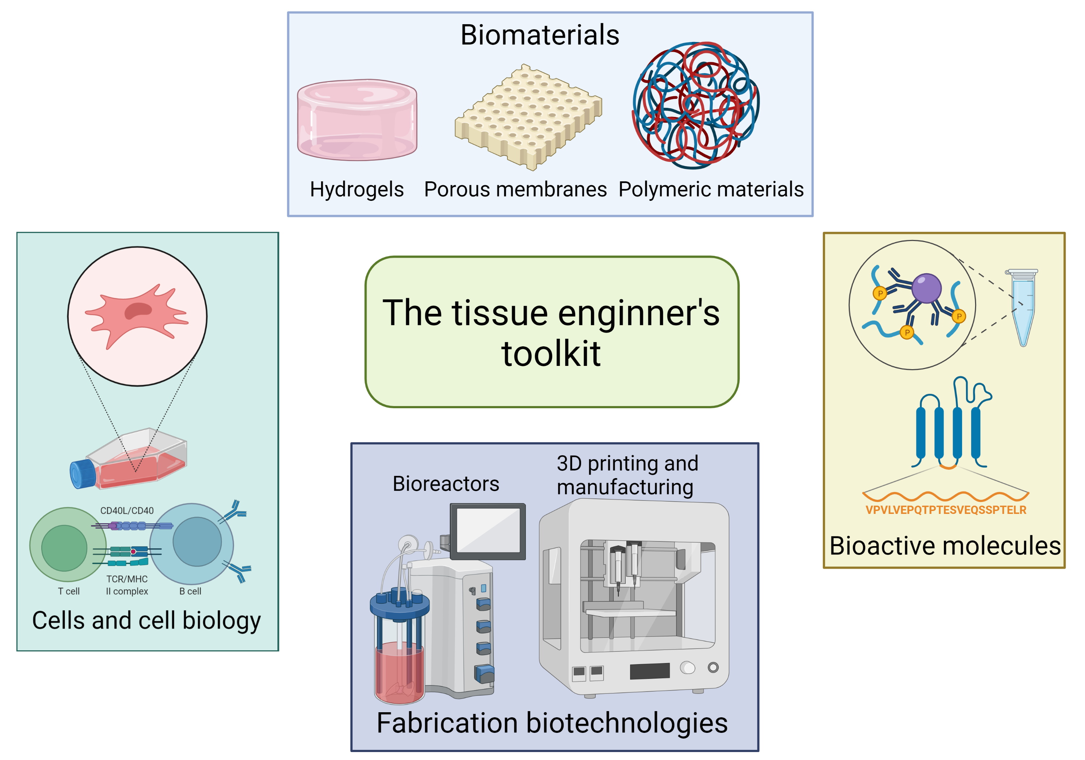
Notes:
Figure 1.1: General scheme of the tissue engineer’s toolkit.
Created with Biorender.com

Slide 3
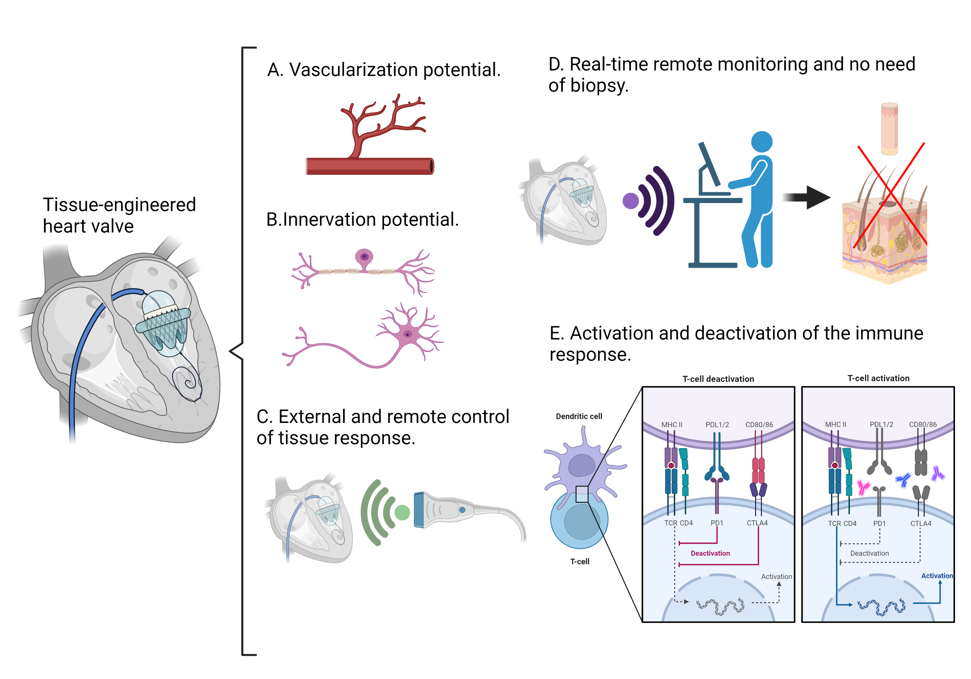
Notes:
Figure 1.2: The most pressing and contemporary problems with tissue-engineered organs and tissues. An engineered heart valve is used as example.
Created with Biorender.com

Slide 4
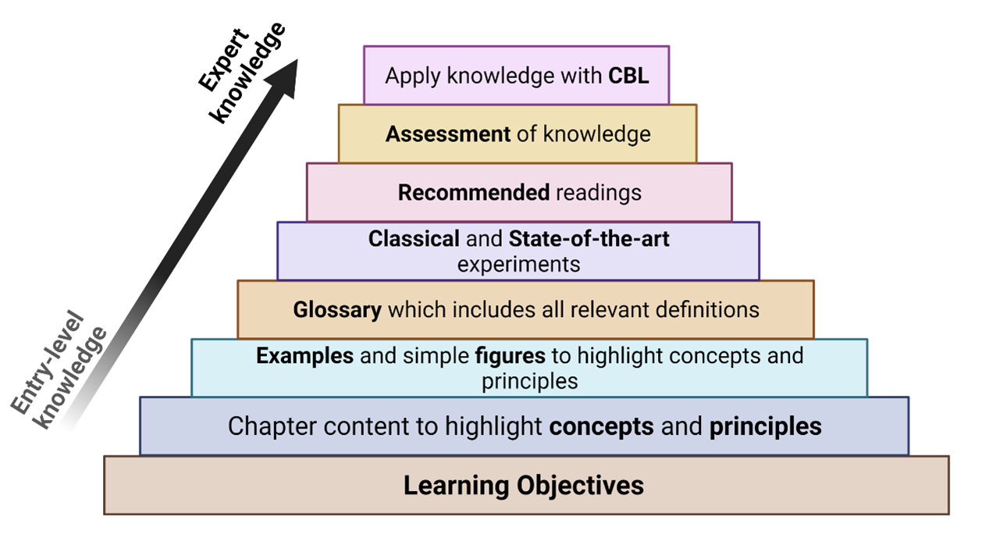
Notes:
Figure 1.3. The structure of each chapter is designed to understand, apply, analyze, evaluate, and ultimately create new Tissue Engineering knowldge.
Created with Biorender.com

